Slide 1

Capstone Project:
Sentiment Analysis on Financial Headlines
Chong sze huan, leila

Slide 2
CONTENT
Problem statement
Preprocessing
Word embedding
BERT model
FinBERT model
Conclusion
Deployment
Q&A

Slide 3
Problem Statement
The financial industry generates a vast amount of textual data, such as news articles, press releases, and earnings reports. Extracting sentiment from this data is crucial for making informed investment decisions. However, traditional sentiment analysis models often struggle to accurately capture the nuances and complexities of financial language. To overcome this challenge, I propose using word embedding model, BERT, and FinBERT, to improve the accuracy of sentiment analysis on financial news.
The objective of this project is to perform sentiment analysis on financial news to classify the sentiment of the news as positive, negative or neutral. The metric used are accuracy and f1 score.

Slide 4
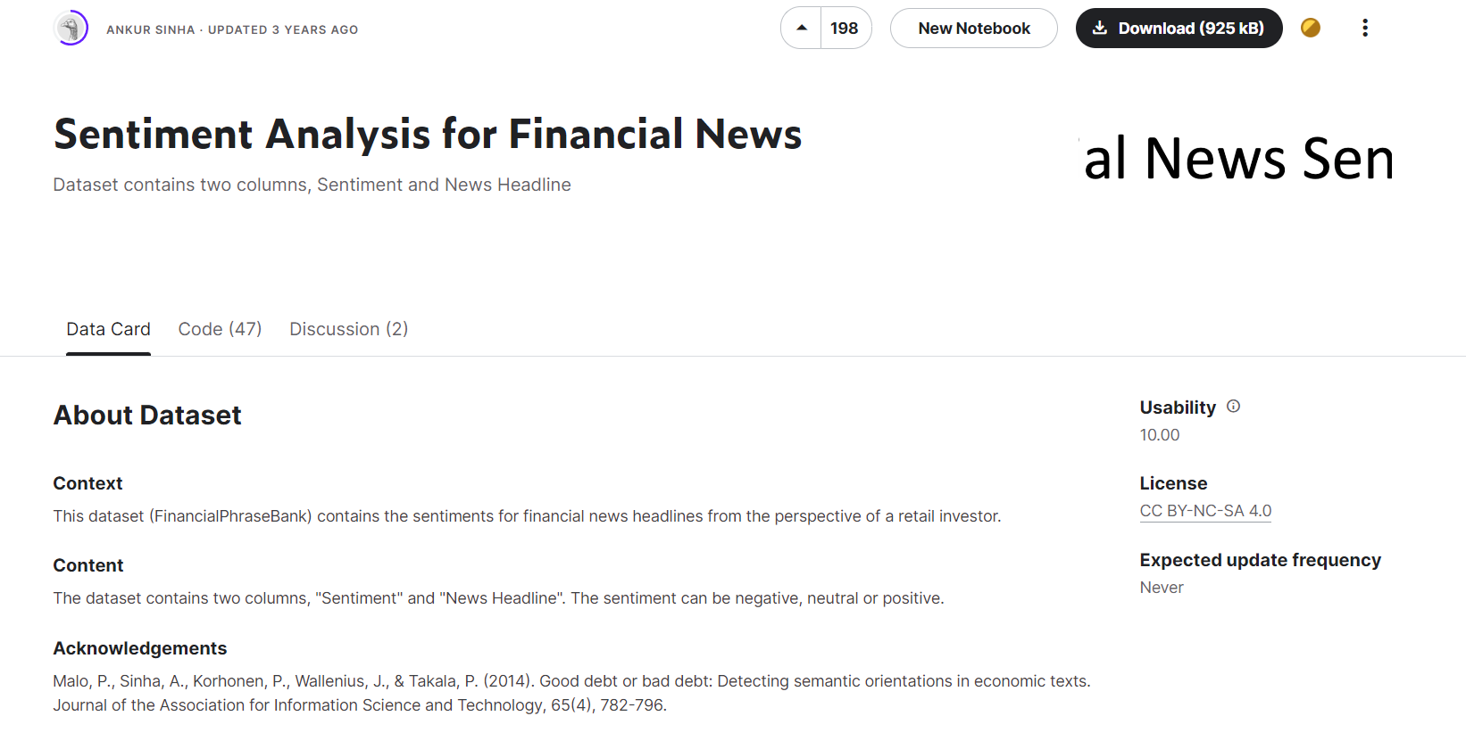
Dataset from Kaggle
4846 headlines
3 sentiments: positive, neutral and negative
Imbalance class
  Neutral 59%
  Positive 28%
  Negative 12%

Slide 5
Preprocessing
Lowercase
Encode the target variables to integers
  Negative -1
  Neutral 0
  Positive 1
Train-test split x2
  Training set 60%
  Validation set 20%
  Testing set 20%

Slide 6
Word Embedding using
Keras API of Tensorflow
Word embedding is a technique used in natural language processing (NLP) that converts words into a numerical vector representation.
This vector representation captures the semantic and syntactic relationships between words, making it easier for machine learning algorithms to process and analyze text data.
Word embedding is typically achieved by training a neural network, on a large corpus of text data.

Slide 7
Word Embedding
Tokenization | sequencing | padding | modeling
Create vocabulary | Convert text to integer sequence | Pad the sequence to a predefined length with token ‘0’ | Neutral Network Model Embedding Layer GlobalAveragePooling1D Dense layer with ‘relu’ Dropout layer Dense layer with ‘softmax’
 |  |  | Compilation Optimizer: Adam Loss function: 'sparse_categorical_crossentropy’ Metric: Accuracy

Slide 8
Adjusted Parameters
Learning rate from 0.0001, 0.001 to 0.01
Embedding dimension from 100 to 80 to 70
Dropout rate from 0.2, 0.4, 0.6 to 0.7
Model without using classweight, and using classweight to account for imbalance class
 | Learning rate | Embedding dimension | Dropout rate | Balanced classweight | Training accuracy | Validation accuracy | Testing accuracy | Testing weighted average F1
E.Model 1.3 | 0.001 | 80 | 0.2 | No | 0.9157 | 0.7399 | 0.75 | 0.74
E.Model 1.8 | 0.001 | 80 | 0.6 | yes | 0.7867 | 0.7503 | 0.77 | 0.77

Slide 9
What is BERT?
BERT (Bidirectional Encoder Representations from Transformers) is a transformers model pretrained on a large corpus of English data in a self-supervised fashion. It is developed by Google in 2018.
The BERT model was pretrained on BookCorpus (800M words) and English Wikipedia (2500M words). BERT was pretrained with two objectives:
Masked language modeling (MLM): 15% of tokens were randomly masked, and the training objective was to predict the original token given its context. It allows the model to learn a bidirectional representation of the sentence.
Next sentence prediction (NSP): the training objective was to classify if two spans of text appeared sequentially in the training corpus.
After pre-training, BERT can be fine-tuned with fewer resources on smaller datasets to optimize its performance on specific tasks such as NLP tasks (language inference, text classification) and sequence-to-sequence based language generation tasks (question-answering, conversational response generation).

Slide 10
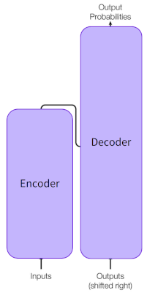
A Vanilla Transformer
The encoder takes an input sequence of tokens, such as words or subwords, and generates a sequence of hidden representations (embedding) that capture the meaning of the input.
The decoder takes these hidden representations (embedding) and generates an output sequence of tokens, such as words or subwords, one token at a time.

Slide 11
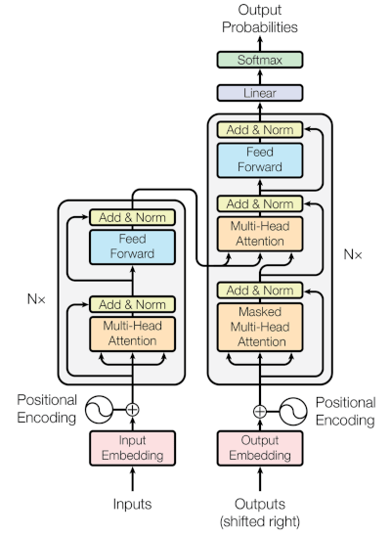
BERT is an encoder-only architecture
The self-attention layer allows the model to attend to all the words in the input sentence simultaneously.
The feedforward layer applies a non-linear transformation to the hidden representations.
BERT makes use of Transformer, an attention mechanism that learns contextual relations between words (or sub-words) in a text.
The self-attention mechanism works by computing attention weights between each element in the sequence and all the other elements in the sequence. These attention weights determine how much importance to place on each element when computing the representation of each element.
Example: ["The", "cat", "sat", "on", "the", "mat"].
The self-attention layer allows the model to attend to all the previously generated output tokens.
The encoder-decoder attention layer allows the model to attend to the output of the encoder.
The feedforward layer applies a non-linear transformation to the hidden representations.

Slide 12
BERT captures context and meaning of words
Unlike traditional word embedding models, BERT considers the entire context of a word in a sentence, rather than just the words that appear before or after it. This allows BERT to capture more complex relationships between words and improve the accuracy of NLP tasks.
Example:
"He is running a company“
"He is running a marathon"
Context-free models such as word2vec or GloVe generate a single word embedding representation for each word in the vocabulary, where BERT takes into account the context for each occurrence of a given word and provides a different contextualized embedding to them.

Slide 13
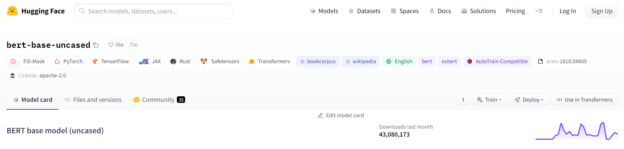
bert-base-uncase

Slide 14
BERT Model
Tokenization | sequencing | padding | modeling
Bert Tokenizer | Convert text to integer sequence | Pad the sequence to a predefined length with token ‘0’ | Fine Tuned Model Bert-based-uncased model Dense layer with ‘relu’ Dropout layer Dense layer with ‘softmax’
 |  |  | Compilation Optimizer: Adam Loss function: 'sparse_categorical_crossentropy’ Metric: Accuracy

Slide 15
BERT Tokenizer WordPiece Algorithm
Tokenizer
Words
Character
Subwords
Others
Wordpiece
Byte Pair Encoding (BPE)
Unigram Language Model (ULM)
Sentence Piece
Word Boundary Tokenizer (WBT)
Others
Word | Token(s)
surf | [‘surf’]
surfing | [‘surf’, ‘##ing’]
surfboard | [‘surf’, ‘##board’]
surfboarding | [‘surf’, ‘##board’, ‘##ing’]
snow | [‘snow’]
snowing | [‘snow’, ‘##ing’]
snowboard | [‘snow’, ‘##board’]
snowboarding | [‘snow’, ‘##board’, ‘##ing’]
Source: https://towardsdatascience.com/how-to-build-a-wordpiece-tokenizer-for-bert-f505d97dddbb
Notes:
Words - sentiment analysis, topic modeling, or machine translation.
Character - text generation tasks, such as language modeling or neural machine translation
WordPiece first initializes the vocabulary to include every character present in the training data and progressively learns a given number of merge rules. In contrast to BPE, WordPiece does not choose the most frequent symbol pair, but the one that maximizes the likelihood of the training data once added to the vocabulary. Maximizing the likelihood of the training data is equivalent to finding the symbol pair, whose probability divided by the probabilities of its first symbol followed by its second symbol is the greatest among all symbol pairs. E.g. "u", followed by "g" would have only been merged if the probability of "ug" divided by "u", "g" would have been greater than for any other symbol pair. Intuitively, WordPiece is slightly different to BPE in that it evaluates what it loses by merging two symbols to ensure it’s worth it.

Slide 16
Adjusted Parameters
Learning rate 0.001 to 0.0001
Model without using classweight, and using classweight to account for imbalance class
 | Learning rate | Embedding dimension | Dropout rate | Balanced classweight | Training accuracy | Validation accuracy | Testing accuracy | Testing weighted average F1
E.Model 1.3 | 0.001 | 80 | 0.2 | No | 0.9157 | 0.7399 | 0.75 | 0.74
E.Model 1.8 | 0.001 | 80 | 0.6 | yes | 0.7867 | 0.7503 | 0.77 | 0.77
B.Model 2 | 0.0001 | - | 0.2 | No | 0.9635 | 0.8669 | 0.84 | 0.84

Slide 17
What is FinBERT?
FinBERT is a variant of BERT that is specifically designed for financial text data. It was developed by the team at Bloomberg and is based on the popular BERT architecture
FinBERT is pre-trained on the following three financial communication corpus. The total corpora size is 4.9B tokens.
Corporate Reports 10-K & 10-Q: 2.5B tokens
Earnings Call Transcripts: 1.3B tokens
Analyst Reports: 1.1B tokens
This model was fine-tuned on 10,000 manually annotated (positive, negative, neutral) sentences from analyst reports and achieved superior performance on financial tone analysis task. FinBERT has been shown to outperform traditional NLP models on financial tasks, demonstrating the value of specialized pre-training on domain-specific data.

Slide 18
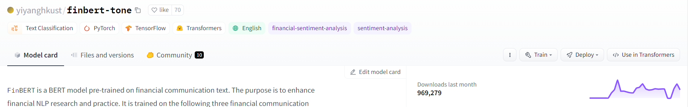
Yiyanghkust/finbert-tone

Slide 19
FinBERT Model
Tokenization | sequencing | padding | modeling
Bert Tokenizer | Convert text to integer sequence | Pad the sequence to a predefined length with token ‘0’ | Fine Tuned Model yiyanghkust/finbert-tone model Dense layer with ‘relu’ Dropout layer Dense layer with ‘softmax’
 |  |  | Compilation Optimizer: Adam Loss function: 'sparse_categorical_crossentropy’ Metric: Accuracy

Slide 20
Adjusted Parameters
Max length of sequence 134 to 80
Dropout rate 0.2 to 0.3
Model without using classweight, and using classweight to account for imbalance class
 | Learning rate | Embedding dimension | Dropout rate | Balanced classweight | Training accuracy | Validation accuracy | Testing accuracy | Testing weighted average F1
E.Model 1.3 | 0.001 | 80 | 0.2 | No | 0.9157 | 0.7399 | 0.75 | 0.74
E.Model 1.8 | 0.001 | 80 | 0.6 | yes | 0.7867 | 0.7503 | 0.77 | 0.77
B.Model 2 | 0.0001 | - | 0.2 | No | 0.9635 | 0.8669 | 0.84 | 0.84
FinB.Model 1.1 | 0.0001 | - | 0.3 | No | 0.7898 | 0.8431 | 0.85 | 0.84

Slide 21
Conclusion
Word embedding is a technique that represents words as numerical vectors, which can be used to capture the semantic relationships between words. However, it does not capture the context in which words are used, which leads to inaccurate sentiment analysis.
BERT, on the other hand, is a pre-trained language model that uses a bidirectional transformer architecture to capture the context in which words are used. However, BERT is computationally expensive to fine-tune the model.
FinBERT is a pre-trained language model that has been specifically designed for financial sentiment analysis. It is based on the BERT architecture and has been fine-tuned on financial news articles and social media posts.
In this project, FinBERT has been shown to achieve higher accuracy in financial sentiment analysis than the general-purpose language model BERT, with reported accuracy rates of up to 85% and weighted average F1 score of up to 84%.

Slide 22
Deployment

Slide 23

Q & A

Slide 24

This Photo by Unknown Author is licensed under CC BY-SA

